Slide 1
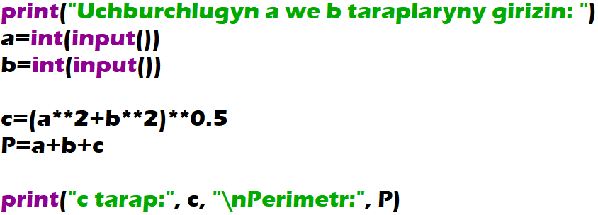
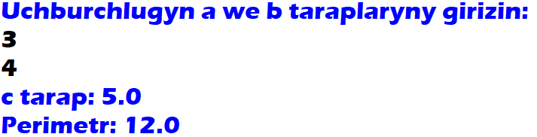
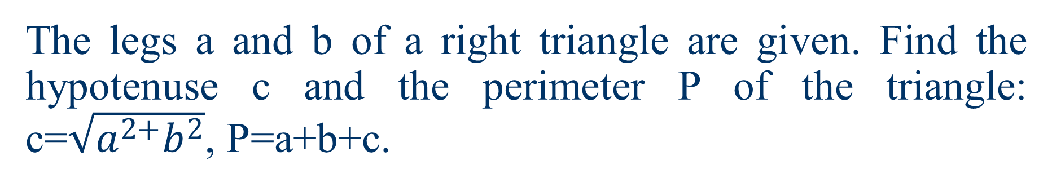
The legs a and b of a right triangle are given. Find the hypotenuse c and the perimeter P of the triangle: c=$\sqrt{a^{2+}b^{2}}$, P=a+b+c.

Slide 2
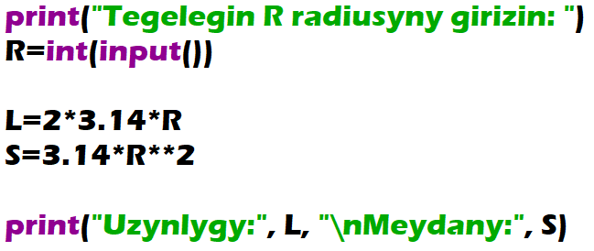
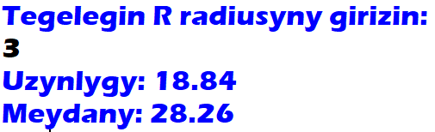
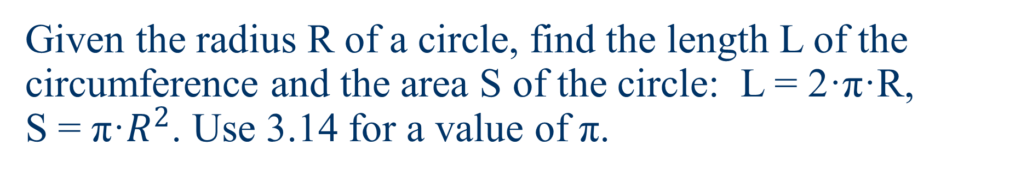
Given the radius R of a circle, find the length L of the circumference and the area S of the circle: L = 2·π·R, S = π·$R^{2}$. Use 3.14 for a value of π.

Slide 3
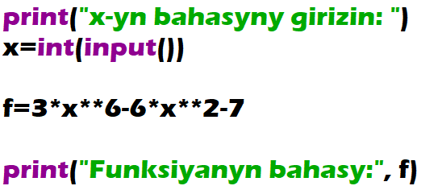
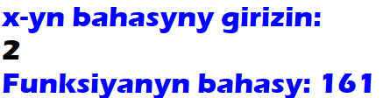
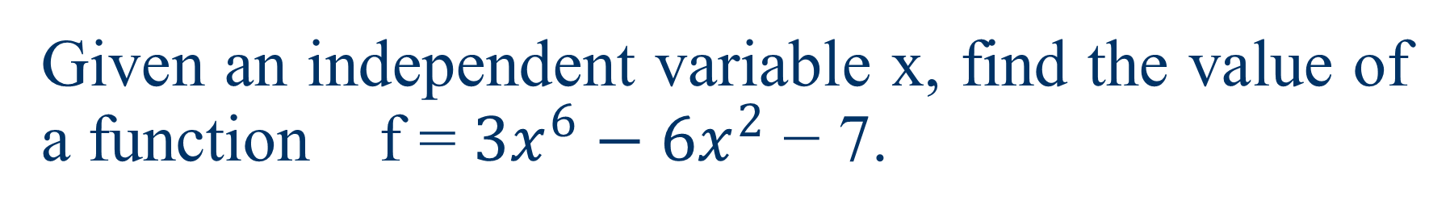
Given an independent variable x, find the value of a function f = ${3x}^{6}−{6x}^{2}$ − 7.

Slide 4
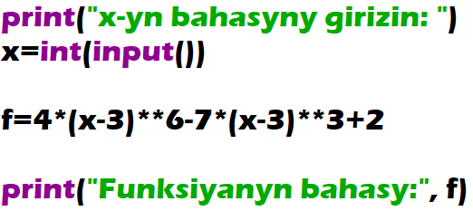
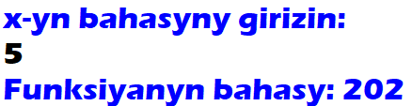
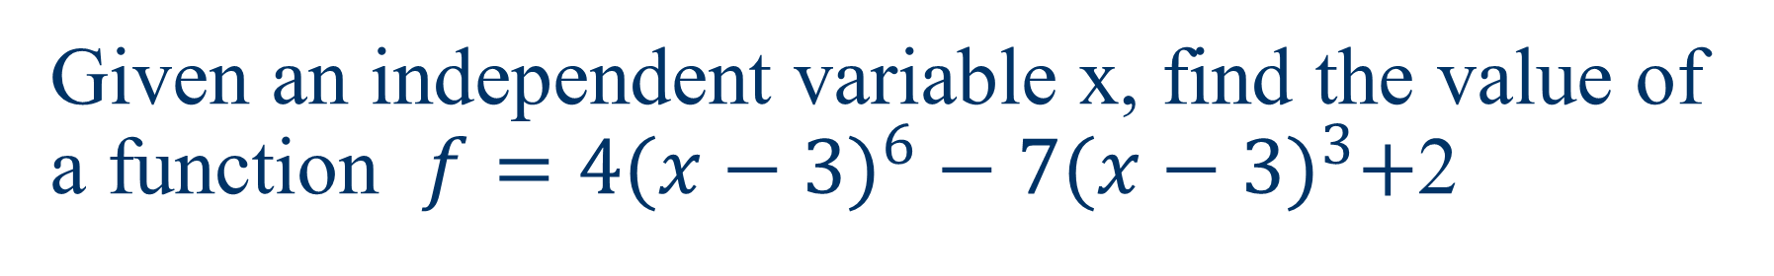
Given an independent variable x, find the value of a function $f={4(x−3)}^{6}−7{(x−3)}^{3}+$2

